Slide 1
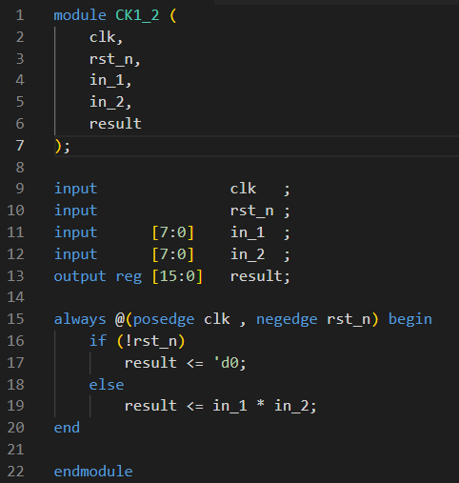
Module
Module frame
Variable declare
Module body

Slide 2
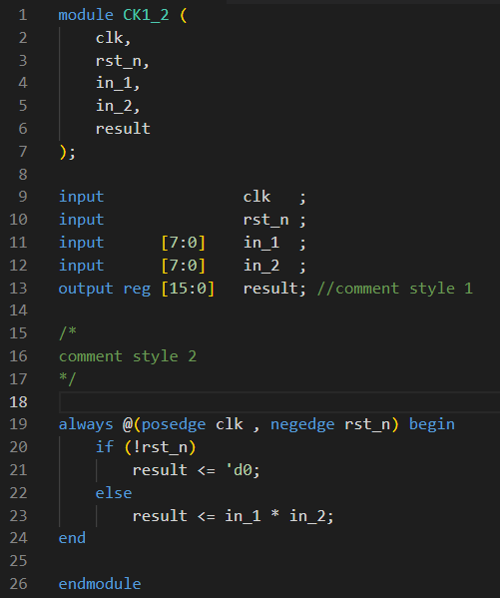
Basic Syntax
End statements with ;

Slide 3
Basic Syntax
Two style of comments
Single line comment after “//”.
Block comment from “/*” to “*/”.

Slide 4
Basic Syntax
Use begin … end to compound statements.
{} is used to combine signals in verilog.

Slide 5
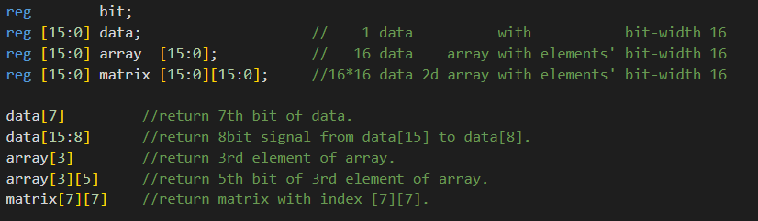
Declare variable
<type> [MSB:LSB] <variable>
Type : reg or wire for RTL.
[MSB:LSB]: determine bit width.

Slide 6
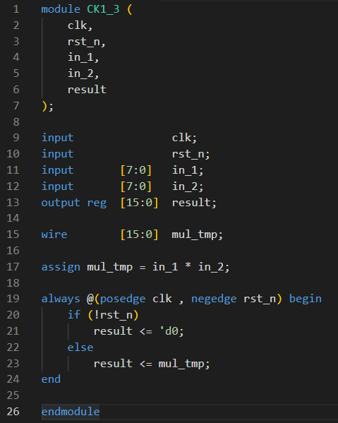
Data type
wire
Continuously driven signal.
Use “assign” to assign a value or operations.
Only for combinational signals.
assign only be used outside always blocks.
Default type of output ports is wire.

Slide 7
Data type
reg
Default is X (unknown).
Assigned in always block.
For combinational or sequential signals.
Can not be assigned by 2 or more always blocks for RTL design.
Data type | wire | reg
assignment | assign | Always block
Combinational | O | O
Sequential | X | O

Slide 8
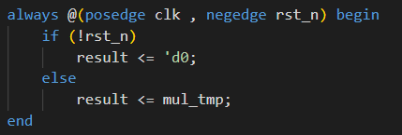
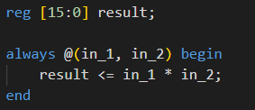
Always Block
Event driven block.
Start procedure if event triggered.
Can be used for combinational or sequential blocks.

Slide 9
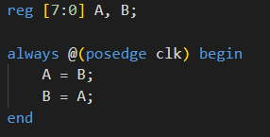
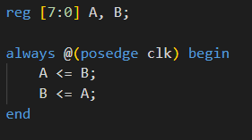
Blocking and non-blocking assignment
Blocking assignment (=)
Non-blocking assignment (<=)
Execute statements line by line.
As B = A = B, A and B will stuck at same value.
Execute statements at same time.
Swap A and B every cycle.
Highly recommended for sequential circuits.

Slide 10
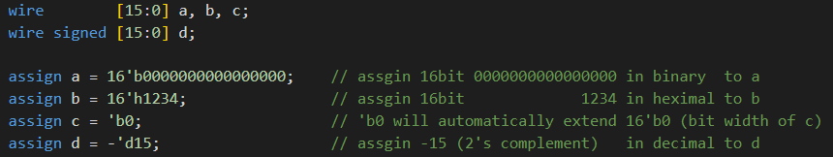
Value Representation
Value format:
Constant: <size>’<base><value>
<size> : bit width.
<base> : b, o, d, h.
<value> : value in <base> representation

Slide 11
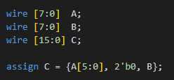
Bus Concatenation

Slide 12
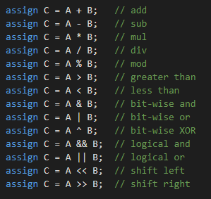
Operations

Slide 13
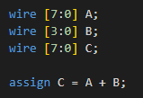
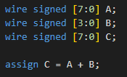
Signed Issue
B will be zero extended to 8 bits.
B will be sign extended to 8 bits.
Both operands must be signed.

Slide 14
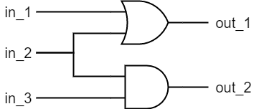
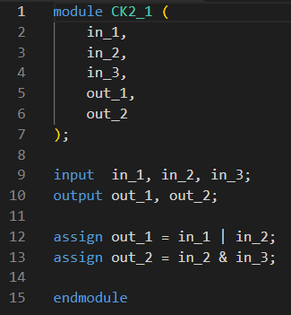
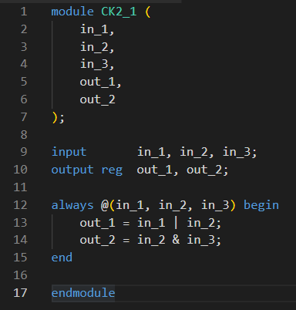
Combinational Circuit

Slide 15
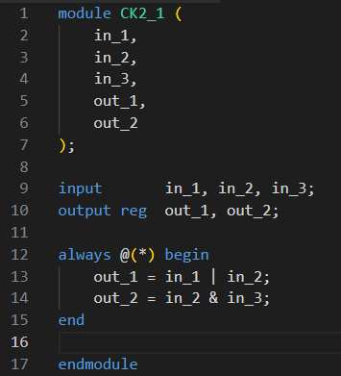
Combinational Circuit
recommended

Slide 16
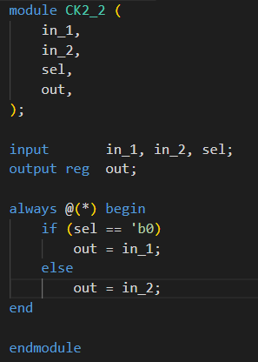
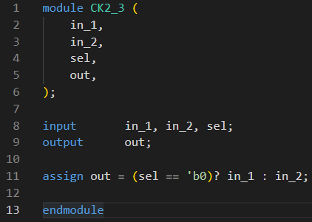
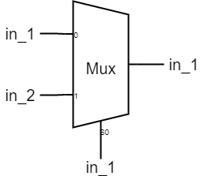
If-else
in-line style

Slide 17
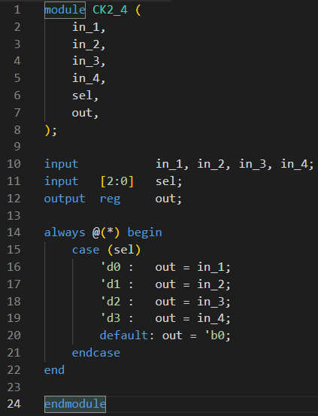
Case

Slide 18
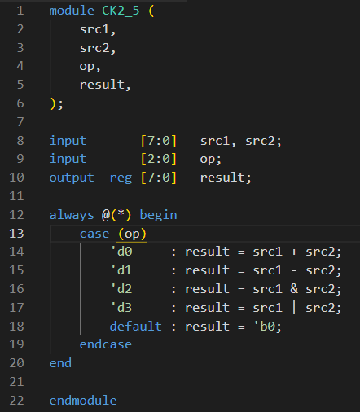
ALU with Case

Slide 19
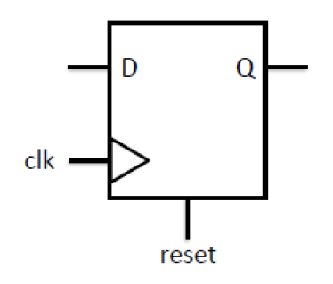
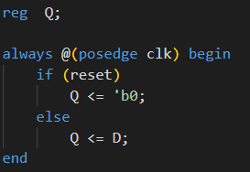
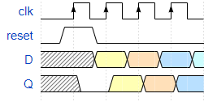
Sequential circuit
Active high and Synchronous reset

Slide 20
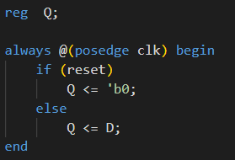
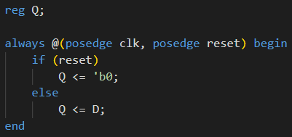
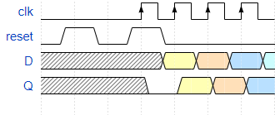
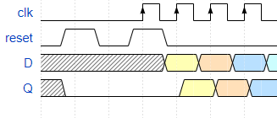
Synchronous and Asynchronous Reset
Synchronous & active high
Asynchronous & active high

Slide 21
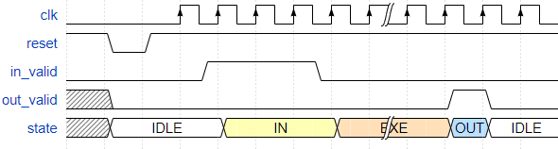
Finite State Machine (FSM)
S_IDLE
S_OUT
Next state
generator
S_IN
S_EXE
Current state
Next state
Current state
register

Slide 22
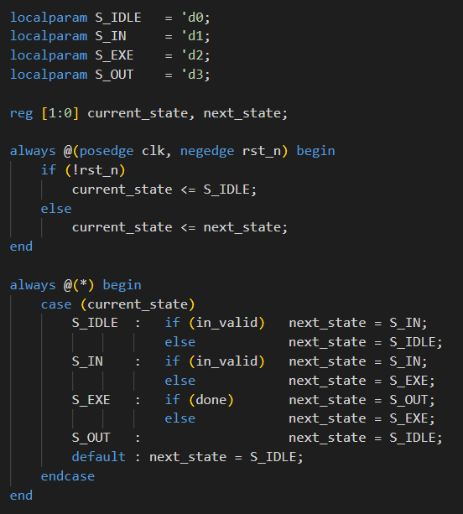
Finite State Machine (FSM)
Next state
generator
Current state
Next state
sequential
Current state
register
combinational

Slide 23
Finite State Machine (FSM)
S_IDLE
S_OUT
S_IN
S_EXE
combinational

Slide 24
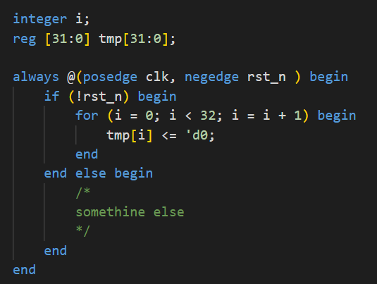
for loop example

